Slide 1

C++ on small microcontrollers
Introduction & workshop
Wouter van Ooijen MSc (ir)
Hogeschool Utrecht, Netherlands,
senior lecturer Computer Engineering
wouter.vanooijen@hu.nl
Meeting C++ Berlin 2015 : Embedded (& parallelism)

Slide 2
Content
Get some terms right
Micro-controller compared to desktop
Basic micro-controller development tools
Blink a LED on the bare metal
Using C++ OO abstractions
Using C+ template-based abstractions

Slide 3
Embedded – a meaning
Means:
part of something larger (not stand-alone)
subservient to that larger thing
with a dedicated task (not general-purpose).
Note that this does not imply a particular type of hardware or style of programming.
Often computer hardware is used for embedded systems that is the same or very similar to what is used on a desktop.

Slide 4
Embedded – some differences
The computer hardware is part of the product
The price of the hardware is reflected in the price of the product.
There is economic pressure to be efficient (use the cheapest posible hardware).
Often the ‘larger thing’ has (hard) real-time requirements.
The embedded system must (always) be fast enough.
Often the system is used to control real hardware.
➔ Failures have interesting consequences (up to loss of life).

Slide 5
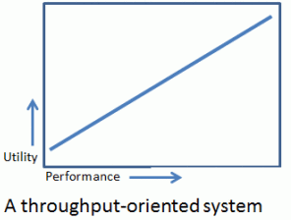
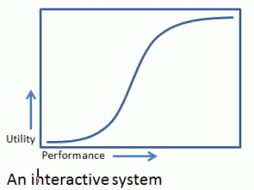
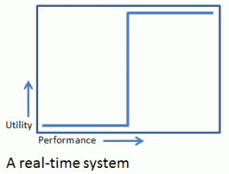
Real-Time
Means: utility depends critically on some timing parameter.
Variations (terms vary):
Firm real-time: may occasionally be late or lower-quality (video)
Soft real-time: usefulness degrades (rapidly)

Slide 6

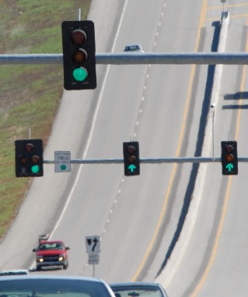

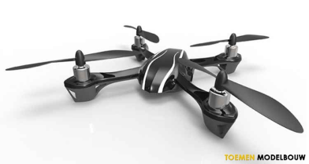
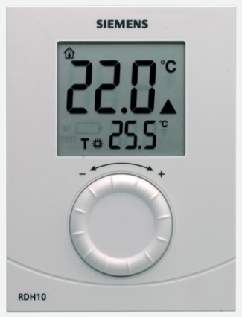

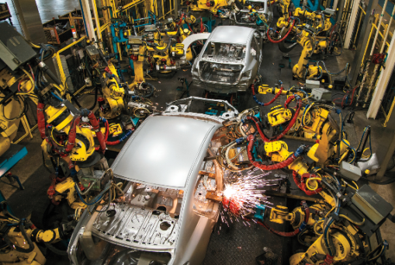


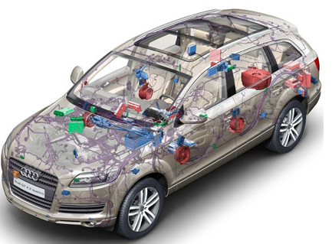
Embedded a wide range of seriousness
Consequently, a wide range of development styles: JBF*, Agile, waterfall, …
* ”Jan Boere Fluitjes”: Dutch saying, meaning roughly ‘casual, with as little effort as possible’

Slide 7
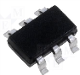
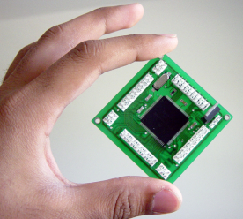
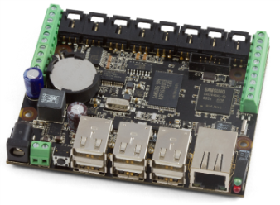
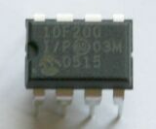
Embedded a wide range of hardware capabilities
1Kb
1Mb
1Gb
4-bit
64-bit
8-bit : 8051, PIC, AVR, …
No full standard C/C++
16-bit : MSP430, PIC, …
32-bit : ARM, MIPS, Intel, …

Slide 8

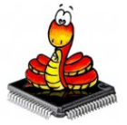


Embedded a wide range of hardware capabilities
1Kb
1Mb
1Gb
Wide range of ‘support software’:
Bare metal: libraries, but no OS
Desktop OS:
Linux
Windows
RTOS

Slide 9
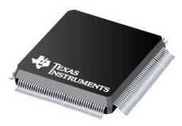
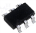
Microcontrollers
Price | E 0.30 | E 50.00
Number of I/O pins | 4 | 400
Clock frequency | 4 MHz | 400 MHz
Flash ROM | 256 instructions | 4 Mb
RAM | 16 bytes | 512 Kb
Word size | 8 | 32

Slide 10

Compared with a desktop
Price | E 300 | E 0.30 | 1000 | E 50 | 6
Number of I/O pins | ? | 4 | ? | 400 | ?
Clock frequency | 3 GHz | 4 MHz | 750 | 400 MHz | 7.5
Flash ROM | 1 Tb (Hd) | 256 | 4’000’000’000 | 4 Mb | 250’000
RAM | 4 Gb | 16 b | 250’000’000 | 512 Kb | 8’000
Word size | 64 | 8 | 8 | 32 | 2
(with some rounding..)

Slide 11

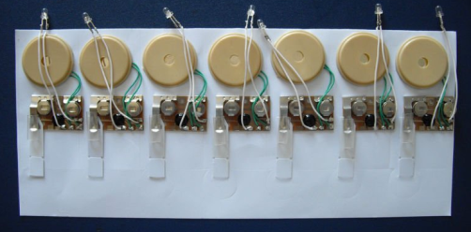

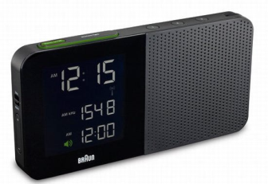
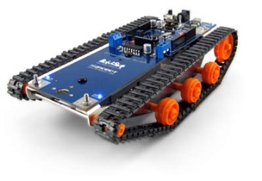

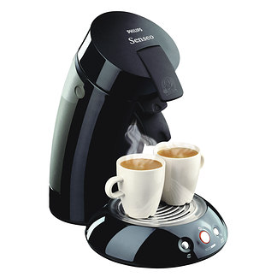

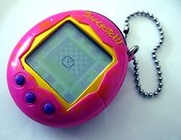
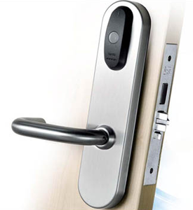
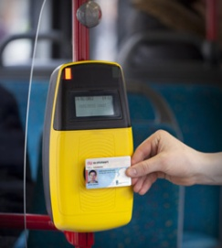
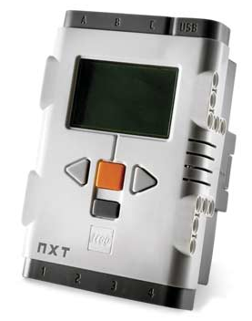
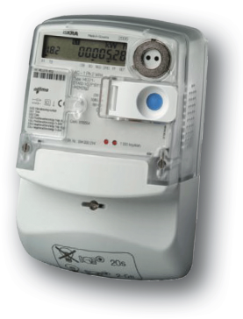
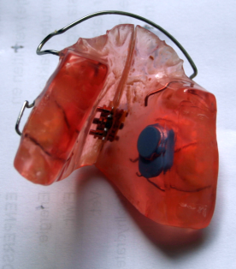
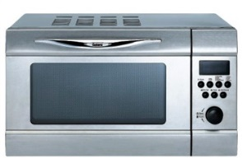



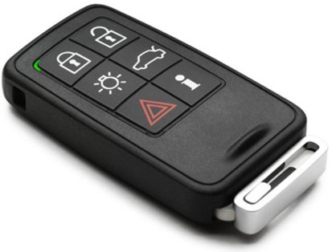
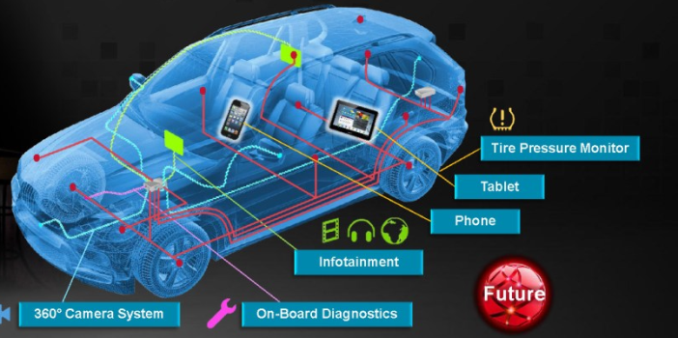
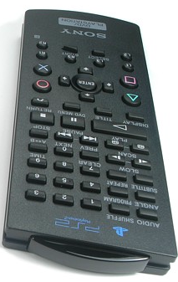


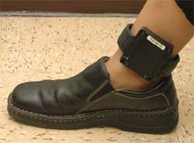
Micro-controllers are everywhere

Slide 12
Small microcontroller economics
Product cost scales with use of resources:
CPU speed (power consumption!!)
code size (Flash)
data size (RAM)
Those prices are payed by the manufacturer, not by the end user (as for desktop software).
➔ Pressure on the developers to reduce resource use: every data byte, instruction counts (even if only in the perception of the managers).

Slide 13
Small micro-controller programming
Typically
Applications are small
Volumes are high
Worst-case timing constraints must be met (average timing is not important)

Slide 14
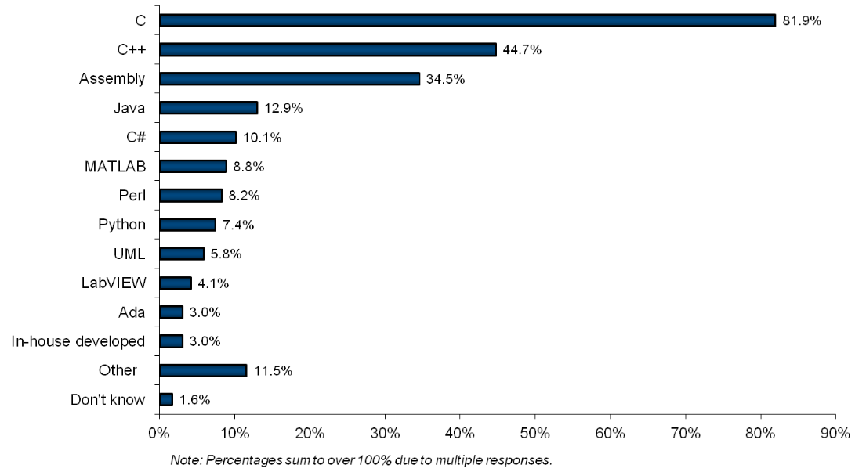
Embedded programming languages
VDC survey 2010; languages *used*, != LOC

Slide 15


Use across the spectrum
1Kb
1Mb
1Gb
C++ gap
C
Assembly
C++, C, Java, C#, Perl, Python, …

Slide 16
So why should C++ be used?
As a better C
(same procedural programming style, but with less room for errors)
Enables other programming styles
(OO, functional, templates, compile time, . . .)
More opportunities for (efficient) code re-use

Slide 17
But not like C++ on a desktop…
Heap: forget it
(if needed: per-size pools)
Floating point: often not practical
(no HW FPU, SW FP library is large and slow)
Exceptions: debatable
(but practical problems)
C++ standard library: large parts are unusable
(heap, float/double, worst-case performance)
OO at run-time (virtual): often not needed
ROM is scarce, RAM even more so
std::ostream, std::cout ??

Slide 18
What do you need
Cross-toolchain:
compiler, linker, tools
Library
Target hardware
Download tool
(Debugger)
Glue to keep it all together
Editor / IDE
These can be separate components, or integrated (Arduino, mbed, Ateml Studio, MPLAB, … )
Launchpad
gcc-arm-embedded
Arduino Due
bmptk
PSPad, CodeLite, …

Slide 19
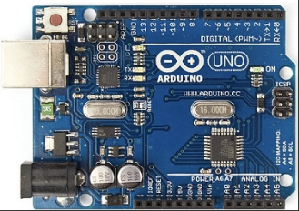
Typical cross development
foo.h
bar.h
library.h
arrow means #include
main.cpp
foo.cpp
bar.cpp
compile
compile
compile
main.o
engine.o
string.o
libraries
link
main.hex
download

Slide 20
A simplified Makefile

Slide 21
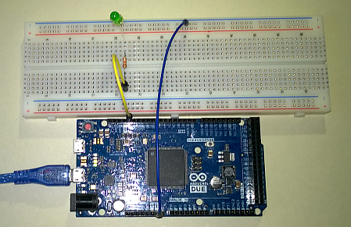
Test case: blink a LED
The embeded way to say “hello world”

Slide 22
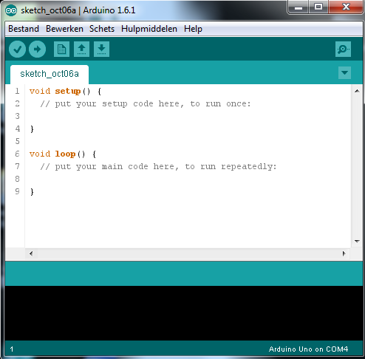
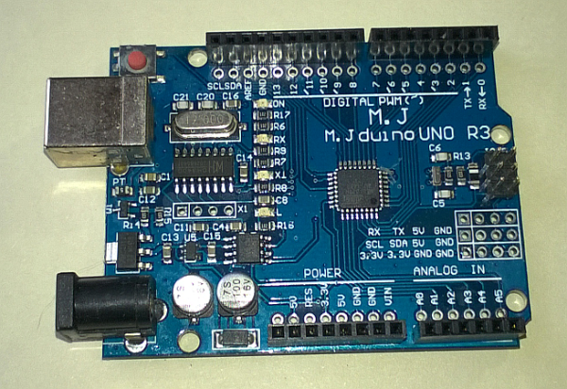
Arduino
Hardware: Uno
Atmel ATMega328 micro-controller:
8 bit CPU, 32k Flash, 2k RAM
USB or wall-wart powered, 5V
USB-to-serial interface, bootloader
Shields (add-on boards)
Software:
Arduino all-in-one SDK
Uses limited form of C++
Shields user from lots of details
‘sketches’ (= applications)
+ cheap hardware, all-in-one SDK, lots of shields, libraries and sketches available
+ has lowered the entry to use of (simple) embedded systems
- incompatible versions, shield limitations, hides details
- C++ compiler is sub-standard, and lacks most libraries

Slide 23
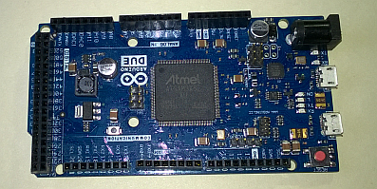
Arduino Due
Hardware: Uno
Atmel SAM3X8E micro-controller:
32 bit Cortex-M3, 512k Flash, 96k RAM
Connections upwards compatible, but 3.3V
Faster, more pins, USB host, …
Standard GCC and libraries
Software: bmptk
Small and simple
Makescript
Use your favorite editor

Slide 24
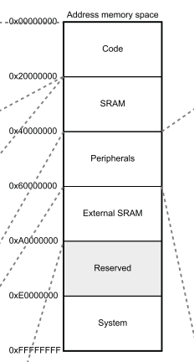
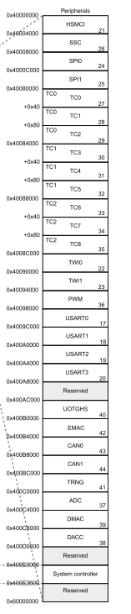
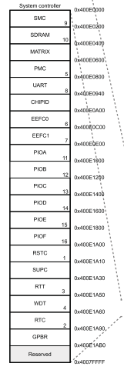
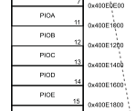
SAM3X memory map
SAM3X datasheet p 31

Slide 25
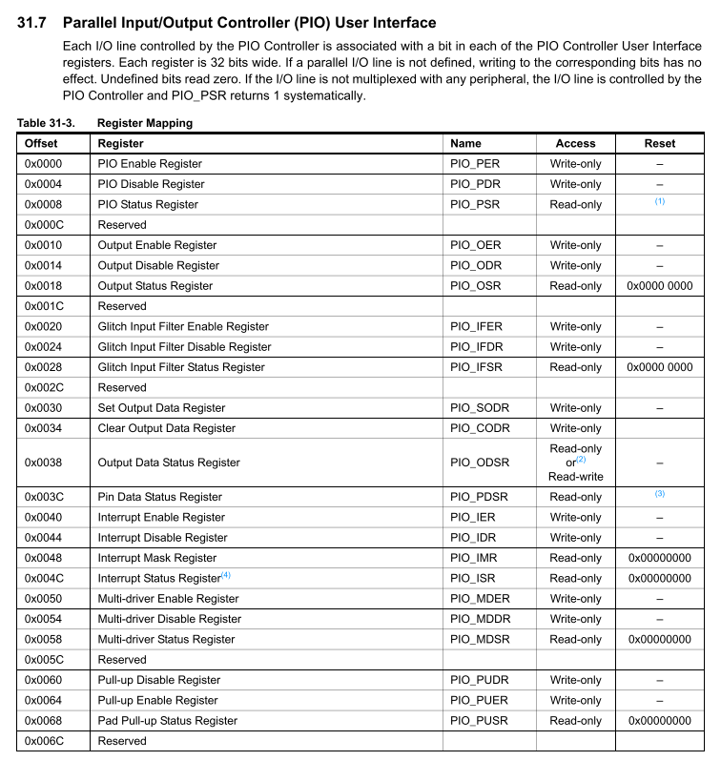
Access to GPIO pins
SAM3X datasheet p 631

Slide 26
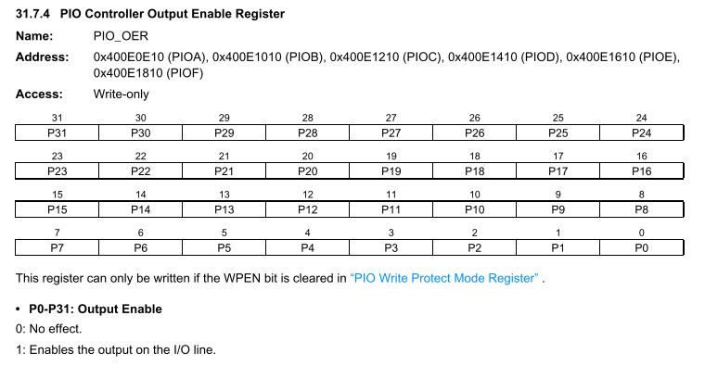
Using GPIO pins - make a pin an output
SAM3X datasheet p 636

Slide 27
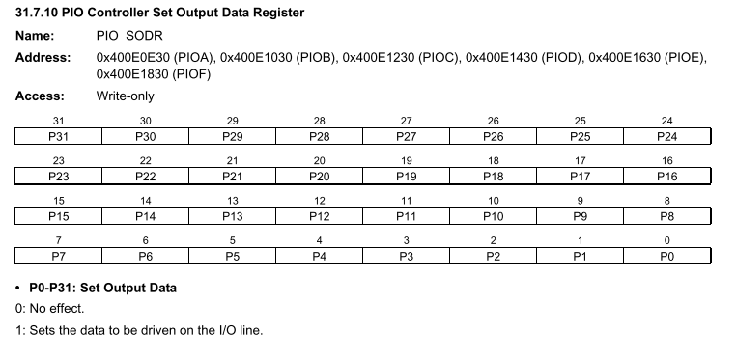
Using GPIO pins - make a pin high (= 1)
SAM3X datasheet p 642

Slide 28
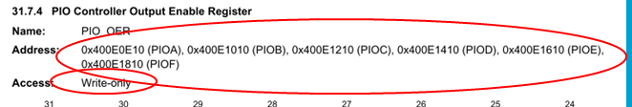
Access to GPIO pins
#define REG_PIOB_OER ( * ( volatile uint32_t* ) 0x400E1010U )
// use:
REG_PIOB_OER = ( 0x1 << 27 );
As separate registers
+ Works in C++, C and assembler
- Code is specific for one port
From various Atmel-provided header files

Slide 29
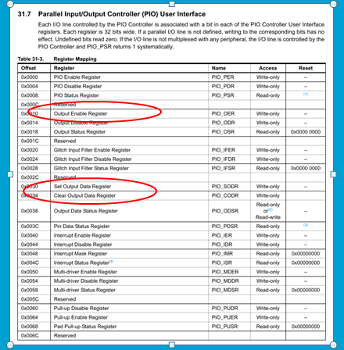
Access to GPIO pins
typedef struct {
volatile uint32_t PIO_PER;
volatile uint32_t PIO_PDR;
volatile uint32_t PIO_PSR;
volatile uint32_t Reserved1[1];
volatile uint32_t PIO_OER;
. . .
volatile uint32_t PIO_SODR;
volatile uint32_t PIO_CODR;
. . .
} Pio;
#define PIOB ( (Pio *)0x400E1000U )
// use:
PIOB->PIO_OER = ( 0x1 << 27 );
As a per-port structure
+ Does not work in assembler
- Code can get a Pio* parameter

Slide 30
Blink a LED in C on PORTB pin 27
int main( void ){
// make the pin an output
PIOB->PIO_OER = ( 0x1 << 27 );
// loop forever
while( 1 ){
// make the pin high
REG_PIOB_SODR = ( 0x1 << 27 );
wait_ms( 200 );
// make the pin low
REG_PIOB_CODR = ( 0x1 << 27 );
wait_ms( 200 );
}
}
Example: 11 - blink in C - direct

Slide 31
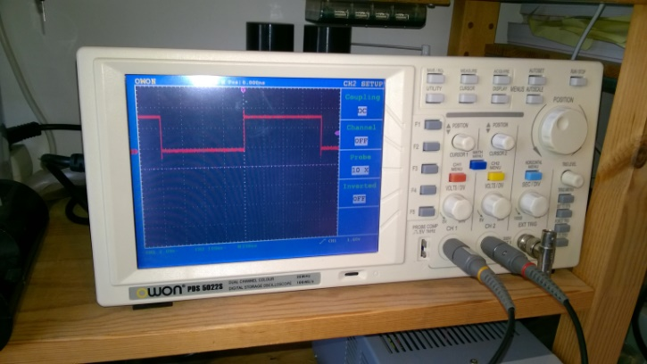
Very ugly wait_ms implementation
void wait_ms( int ms ){
while( ms-- ){
for( volatile int i = 294; i > 0; --i ){}
}
}
void wait_us( int us ){
while( us-- ){
volatile int i = 0;
i = 0;
}
}
Don’t forget ‘volatile’
Better (but more work): use timer hardware

Slide 32
C style: use a macros
#define GPIO_CONFIG_OUTPUT( PORT, PIN ) \
(PORT)->PIO_OER = 0x1 << (PIN)
#define GPIO_SET( PORT, PIN, VALUE ) \
if( VALUE ){ \
(PORT)->PIO_SODR = 0x1 << (PIN); \
} else { \
(PORT)->PIO_CODR = 0x1 << (PIN); \
}
int main( void ){
GPIO_CONFIG_OUTPUT( PIOB, 27 );
while( 1 ){
GPIO_SET( PIOB, 27, 1 );
wait_ms( 200 );
GPIO_SET( PIOB, 27, 0 );
wait_ms( 200 );
}
}
+ Efficient (small & fast)
- Can’t easily be replaced or augmented by the user
- It is a macro! (scope, textual parameters, … )
Example: 12 - blink in C - macro

Slide 33
C style: use functions
void gpio_config_output( Pio *p, int pin ){
p->PIO_OER = 0x1 << pin;
}
void gpio_set( Pio *p, int pin, bool x ){
if( x ){
p->PIO_SODR = 0x1 << pin;
} else {
p->PIO_CODR = 0x1 << pin;
}
}
#define LED PIOB, 27
int main( void ){
gpio_config_output( LED );
while( 1 ){
gpio_set( LED, 1 );
wait_ms( 200 );
gpio_set( LED, 0 );
wait_ms( 200 );
}
}
Example: 12 - blink in C - functions

Slide 34
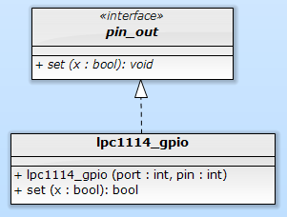
Classic OO pin abstraction
volatile int & gpioreg( int port, int offset ){
return * (volatile int *) ( 0x50000000 + port * 0x10000 + offset );
}
struct due_gpo : public pin_out {
Pio & port;
const uint32_t mask;
due_gpo( Pio & port, int pin )
: port{ port }, mask{ 0x1u << pin }
{
port.PIO_OER = mask;
}
void set( bool x ) override {
( x ? port.PIO_SODR : port.PIO_CODR ) = mask;
}
};
int main( void ){
auto led = due_gpo{ *PIOB, 27 };
while( 1 ){
led.set( 1 );
wait_ms( 200 );
led.set( 0 );
wait_ms( 200 );
}
}
Abstract class with virtual functions

Slide 35
Classic OO pin abstraction
void blink( pin_out & pin ){
for(;;){
pin.set( 1 );
delay();
pin.set( 0 );
delay();
}
}
int main(){
lpc1114_gpio led( 1, 0 );
blink( led );
}
Now we have a gpo pin abstraction, so we can write code independent from the implementation.

Slide 36
Metrics
for set(1) + set(0) + ‘support’ code
PIN_SET( 1, 0, 1 );
PIN_SET( 1, 0, 0 );
pin.set( 1 );
pin.set( 0 );
 | C (macro) | C++ (virtual functions)
Code (bytes Flash) | 16 | 68
RAM | 0 | 12
CPU cycles | ~ 9 | ~ 56
☹
What has gone wrong?

Slide 37
Generated code (C++ OO-style)
void blink( pin_out & pin ){
for(;;){
pin.set( 1 );
delay();
pin.set( 0 );
delay();
}
}
int main(){
lpc1114_gpio led( 1, 0 );
blink( led );
}
push {r4, lr}
mov r4, r0
.L12:
ldr r3, [r4]
mov r0, r4
ldr r3, [r3]
mov r1, #1
blx r3
bl _Z5delayv
ldr r3, [r4]
mov r0, r4
ldr r3, [r3]
mov r1, #0
blx r3
bl _Z5delayv
b .L12
24
_ZN12lpc1114_gpio3setEb:
ldr r3, [r0, #4]
push {r4, lr}
mov r4, #160
lsl r4, r4, #7
add r2, r3, r4
ldr r3, [r0, #8]
mov r0, #4
lsl r2, r2, #16
lsl r0, r0, r3
add r3, r2, r0
neg r1, r1
str r1, [r3]
pop {r4, pc}
ldr r3, .L14
add r0, sp, #4
str r3, [sp, #4]
mov r3, #1
str r3, [sp, #8]
mov r3, #0
str r3, [sp, #12]
bl _Z5blinkR7pin_out
.align 2
.L14:
.word 1342177284
18
26

Slide 38
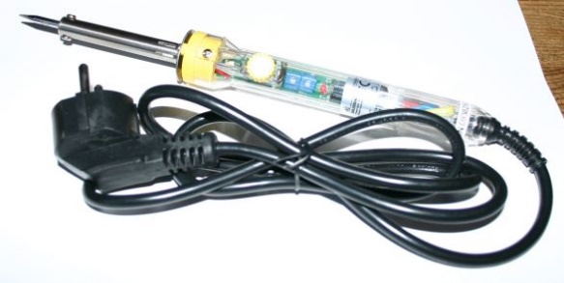
Why so much code?
Run-time polymorphism:
Connection between operation and implementation is made at run time
This takes code, CPU cycles, even some RAM, and blocks optimizations
Fixed-hardware embedded systems don’t need such run-time flexibility, but
Efficient use of libraries does require compile-time flexibility

Slide 39
Alternative: compile-time polymorphism
Static classes (or structs) can be used as compile-time encapsulation of data and operations.
Template parameters can be used to pass such an encapsulation to another one.
These are compile-time-only actions, hence fully visible to the optimizer.

Slide 40
Run-time polymorphism
Compile-time polymorphism
struct pin_out {
virtual void set( bool ) = 0;
};
struct lpc1114_gpio : public pin_out {
lpc1114_gpio( . . . ) . . .
void set( bool x ) override { . . . }
};
struct blink {
pin_out & pin;
blink( pin_out & pin ): pin( pin ){}
void run(){
. . .
pin.set( 1 );
}
}
int main(){
blink( lpc1114_gpio( 1, 2 )).run();
}
struct pin_out_archetype {
typedef void has_pin_out;
static void set( bool value ){}
}
template< int port, int pin >
struct lpc1114_gpio : public pin_out_archetype {
static void set( bool value ){ . . . }
};
template< typename pin >
struct blink {
void run(){
. . .
pin::set( 1 );
}
}
int main(){
blink< lpc1114_gpio< 1, 2 >>::run();
}
As before, some ugly details (initialization, timing, …) are omitted.

Slide 41
Generated code (C versus C++ C-T-P)
// C with macro’s
.L97:
ldr r4, .L98
mov r3, #1
neg r0, r3
str r0, [r4]
bl delay
mov r1, #0
str r1, [r4]
bl delay
b .L97
// C++ with compile-time polymorphism
.L3:
ldr r4, .L5+12
mov r3, #1
neg r3, r3
str r3, [r4]
ldr r0, .L5+16
bl _...waiting_324waitEj
mov r3, #0
str r3, [r4]
ldr r0, .L5+16
bl _...waiting_324waitEj
b .L3
 | C | C++
Code (bytes Flash) | 16 | 16
RAM | 0 | 0
CPU cycles | ~ 9 | ~ 9
☺

Slide 42
Blink: some (ugly?) details
#include "targets/lpc1114fn28.hpp"
typedef hwcpp::lpc1114fn28<> target;
int main(){
hwcpp::blink< target::gpio_1_2, target::waiting >::run();
}
template<
typename arg_pin,
typename arg_timing
> struct blinking {
typedef pin_out_from< arg_pin > pin;
typedef waiting_from< arg_timing > timing;
typedef typename timing::duration duration;
static void run( const duration t = duration::ms( 500 ) ){
timing::init();
pin::init();
for(;;){
pin::set( 1 );
timing::wait( t / 2 );
pin::set( 0 );
timing::wait( t / 2 );
}
}
};
#include "targets/lpc1114fn28.hpp"
typedef hwcpp::lpc1114fn28<> target;
int main(){
hwcpp::blink< target::gpio_0_0, target::waiting >::run();
}
Type narrowing
Explicit initialization

Slide 43
Four pin archetypes
struct pin_in_archetype {
typedef void has_pin_in;
static void init();
static bool get();
};
struct pin_out_archetype {
typedef void has_pin_out;
static void init();
static void set( bool value );
};
struct pin_in_out_archetype {
typedef void has_pin_in_out;
static void init();
static void direction_set_input();
static void direction_set_output();
static bool get();
static void set( bool value );
};
struct pin_oc_archetype {
typedef void has_pin_oc;
static void init();
static bool get();
static void set( bool value );
};

Slide 44
Type narrowing
class target {
typedef . . . pin_a0;
}
typedef target::pin_a0 alarm;
int main(){
alarm::init();
alarm::direction_set_output();
alarm::set( false );
if( . . . ){
alarm::set( true );
}
}
class target {
typedef . . . pin_a0;
}
typedef pin_out_from< target::pin_a0 > alarm;
int main(){
alarm::init();
alarm::direction_set_output();
alarm::set( false );
if( . . . ){
alarm::set( true );
}
}
The template parameter is type-checked
The template adapts to the parameter type
Initialization is ‘complete’
The code can’t accidentally use an inappropriate method

Slide 45
pin_out_from< . . . > template
template< class unsupported, class dummy = void > struct pin_out_from {
static_assert( sizeof( unsupported ) == 0, . . . ); };
template< class pin > struct pin_out_from < pin, typename pin::has_pin_out > :
public pin_out_archetype
{
static void init(){ pin::init(); }
static void set( bool value ){ pin::set( value ); }
};
template< class pin > struct pin_out_from < pin, typename pin::has_pin_oc > :
public pin_out_archetype
{
static void init(){ pin::init(); }
static void set( bool value ){ pin::set( value ); }
};
template< class pin > struct pin_out_from < pin, typename pin::has_pin_in_out > :
public pin_out_archetype
{
static void init(){ pin::init(); pin::direction_set_output(); }
static void set( bool value ){ pin::set( value ); }
};
template< class unsupported, class dummy = void > struct pin_out_from {
static_assert( sizeof( unsupported ) == 0, . . . ); };
template< class pin > struct pin_out_from < pin, typename pin::has_pin_out > :
public pin_out_archetype
{
static void init(){ pin::init(); }
static void set( bool value ){ pin::set( value ); }
};
template< class pin > struct pin_out_from < pin, typename pin::has_pin_oc > :
public pin_out_archetype
{
static void init(){ pin::init(); }
static void set( bool value ){ pin::set( value ); }
};
template< class unsupported, class dummy = void > struct pin_out_from {
static_assert( sizeof( unsupported ) == 0, . . . ); };

Slide 46

Don’t say it in a comment
invert< . . . >
decorator
namespace target {
typedef . . . pin_a0;
}
typedef target::pin_a0 alarm_led;
// the alarm LED pin is active low
constexpr bool alarm_led_active = false;
int main(){
alarm_led::set( ! alarm_led_active );
if( . . . ){
alarm_led::set( alarm_led_active );
}
}
Say it in the code
namespace target {
typedef . . . pin_a0;
}
typedef invert< target::pin_a0 > alarm_led;
int main(){
alarm_led::set( false );
if( . . . ){
alarm_led::set( true );
}
}

Slide 47
Pin invert< . . . > template
template< class unsupported, class dummy = void > struct invert {
static_assert( sizeof( unsupported ) == 0, ". . ." ); };
template< class pin > struct invert< pin, typename pin::has_pin_in > :
public pin_in_archetype {
static void init(){ pin::init(); }
static bool get(){ return ! pin::get(); } };
template< class pin > struct invert< pin, typename pin::has_pin_out > :
public pin_out_archetype {
static void init(){ pin::init(); }
static void set( bool x ){ pin::set( ! x ); } };
template< class pin > struct invert< pin, typename pin::has_pin_in_out > :
public pin_in_out_archetype {
static void init(){ pin::init(); }
static void direction_set_input(){ pin::direction_set_input(); }
static void direction_set_output(){ pin::direction_set_output(); }
static void set( bool x ){ pin::set( ! x ); }
static bool get(){ return ! pin::get(); } };
template< class pin > struct invert< pin, typename pin::has_pin_oc > :
public pin_oc_archetype {
static void init(){ pin::init(); }
static void set( bool x ){ pin::set( ! x ); }
static bool get(){ return ! pin::get(); } };
Often:
ZERO cost!

Slide 48
Some more pin & port decorators
// create the stated pin or port type from p
pin_in_from< p >
pin_out_from< p >
pin_in_out_from< p >
pin_oc_from< p >
port_in_from< p >
port_out_from< p >
port_in_out_from< p >
port_oc_from< p >
// create a port of the stated type from pins
port_in_from_pins< p, ... >
port_out_from_pins< p, ... >
port_in_out_from_pins< p, ... >
// invert the value read from or written to p
invert< p >
// pin or port that writes to all pins or ports
all< p, ... >

Slide 49
Using static class templates: consequences (1)
Abstraction tool is the class template with only static contents (classes, methods, attributes)
Composition is by template instantiation
Method call syntax is class::method(…) instead of object.method(…)
Header-only

Slide 50
Using static class templates: consequences (2)
No objects (of such classes) are created
No memory management, no dangling references
Sharing of identical constructs is automatic
No automatic construction: explicit init() calls
Overhead can be zero

Slide 51

Long term view
A use case
Write library code for reading the temperature from an LM75 chip (I2C interface). Write it once and for all.
What should be in this code?
Getting the data bits from the LM75 (using I2C)
Converting the data bits to a temperature
Maybe detecting errors in the data bits (passing I2C errors along?)
What should NOT be in this code?
I/O pin handling
I2C protocol
Timing
Conversion to the requested datatype (int, float, double, fixed-point, … )
Conversion to the requested unit (Kelvin, Celcius, Fahrenheit, … )
Floating point calls

Slide 52
Next steps
Identify and/or implement abstraction(s) for
Values (units, fixed-point)
Timing (including multithreading)
Error handling
Combine compile-time and run-time paramterization

Slide 53
Devirtualization?
Compilers are starting to do devirtualization (as part of whole-program optimization). How would perfect de-virtualization compare to the static-class-template approach?
Objects + ideal devirtualization | Static class templates
Run-time allocation | Compile/link time allocation
Global, stack or heap allocation | Only global allocation
Danger of dangling references | No such danger
Run-time flexibility | Requires extra effort
Sharing requires planning | Sharing is automatic (prevention is tricky)
Well-known syntax & style | Unfamiliar syntax & style

Slide 54
C++ language issues
Class templates and plain classes can’t have the same name.
The syntax for using static attributes of class templates can be horrible.
A LOT of template and typename prefixes can be required to disambiguate (template parameter-) dependent names.
C++0x11 has override for virtual methods, but there is no equivalent for static methods.

Slide 55

C++ language wish list
Allow override for static methods
Allow a static operator()
Allow template / class name overloading
Allow constexpr char * as template parameter (if possible all constexpr’s ?)
Get rid of (some of) those mandatory template and typename qualifiers
PS: I will NOT donate a kidney.

Slide 56
Summary
Current C++ libraries and programming practices are often not optimal for very small systems.
Compile-time polymorphism using static class templates (no objects!)
Can be as efficient as C macro’s.
Has an abstraction power comparable in power but very different in nature to classic run-time-objects-based OO.
There is a lot of interesting work to do to create C++ libraries that help programming very small systems.

Slide 57
Passing a type – two alternatives
As type
(explicit template parameter)
template< int n, int m >class gpio { . . . };
template< typename x > class invert { . . . };
typedef gpio< 1, 2 > pin_b2;
invert< pin_b2 > led;
As type object
(explicit object parameter == implicit template parameter)
template< int n, int m >class gpio { . . . };
template< typename t > auto invert( t x ){ . . . };
gpio< 1, 2 > pin_b2;
auto led = invert( pin_b2 );

Slide 58
Avoid run-time overhead
By using templates
template< int n, int m >class gpio { . . . };
typedef gpio< 1, 2 > pin_b2;
pin_b::set();
By relying on devirtualization
class gpio { virtual void set() = 0; }
template< int n, int m > class cortex_gpio : gpio {
void set(){ . . . }
}
cortex_gpio< 1, 2 > pin_1_2;
pin_1_2::set();

Slide 59
Have your cake AND eat it with whole-program optimization
class gpio { virtual void set() = 0; }
template< int n, int m > class cortex_gpio : gpio {
void set(){ . . . }
}
cortex_gpio< 1, 2 > pin_1_2;
cortex_gpio< 1, 3 > pin_1_3;
cortex_gpio< 1, 4 > pin_1_4;
void f( gpio & p ){ p.set(); . . . }
pin_1_2.set();
f( pin_1_2 );
void g( gpio & p ){ p.set(); . . . }
g( pin_1_2 );
g( pin_1_3 );
g( pin_1_4 );
Devirtualization:
➔ inline
➔ optimization
Run-time polymorphism

Slide 60
Temporaries . . . ☹
By relying on devirtualization
class gpio { virtual void set() = 0; }
template< typename t > auto invert( t & x ){
}
cortex_gpio< 1, 2 > pin_1_2;

Slide 61


C++ in (very) serious embedded systems
CppCon 2014: Mark Maimone "C++ on Mars: Incorporating C++ into Mars Rover Flight Software"
CppCon2014: Bill Emshoff "Using C++ on Mission and Safety Critical Platforms"

